Slide 1
Survival Analysis for Prostate Cancer Patients
IDS-506
Health Information and Management Analytics
Vivek Kumar

Slide 2
The Case
To determine the 7-year survival of Prostate Cancer Patients based on their medical records, state of cancer, progression of their disease.
Training Data (15,385 records, 33 attributes) with values given for target variable to train the model
Test Data (11,531 records, 33 attributes) with all NAs for target variable

Slide 3
Data Transformation
Transformed Stage Variable : {I : 1, IIA : 2, IIB : 3, III : 4, IV : 5}
Encoded Symptoms to 16 columns, i.e. individual columns representing presence or absence of a symptom
Dropped 't_score', 'n_score’ and 'm_score’ as these combined together forms stage
One hot encoding for Race attribute
For surivial_1_year = 0, updated psa_1_year, psa_6_months, tumor_1_year and tumor_6_months with preceding existing values
For records having equal values in psa_1_year and psa_diagnosis, missing values in psa_6_months was replaced by either of the two
For records having equal values in tumor_1_year and tumor_6_months, missing values in tumor_6_months was replaced by either of the two

Slide 4
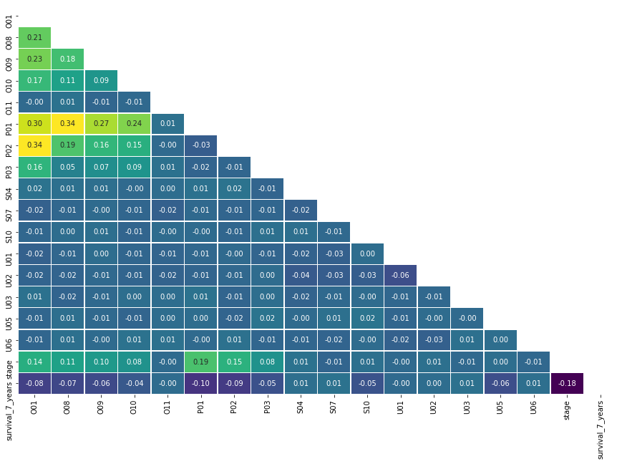
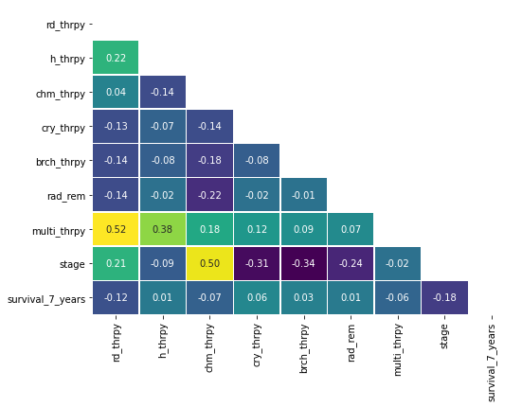
Correlation of Symptoms & Therapy attributes with Target Variable

Slide 5
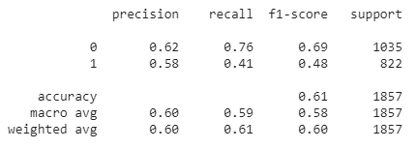
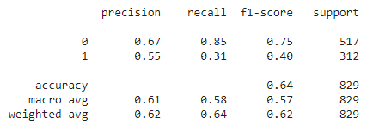
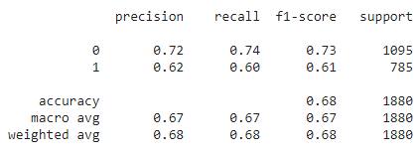
Logistic Regression Models
t=0
t=6 months
t=1 year

Slide 6
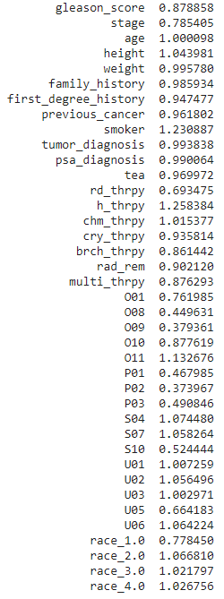
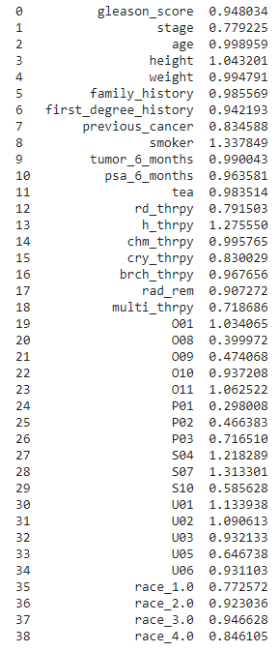
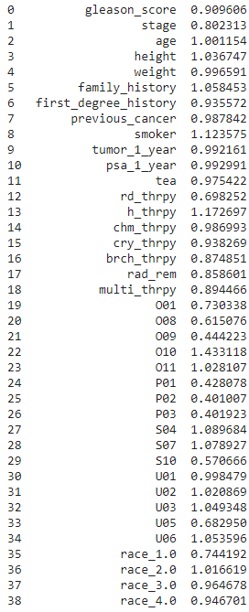
Odds Ratio
t=0
t=6months
t=1year

Slide 7
Survival Analysis
The Survival Function is given by:
S(t) = P(T>t)
where,
T is the lifetime of a member of the population
t denotes time
S(t) is the survival curve at time t

Slide 8
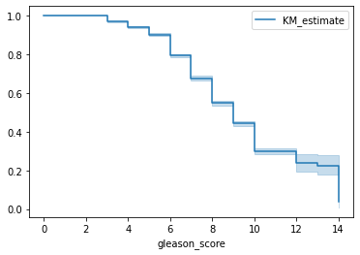
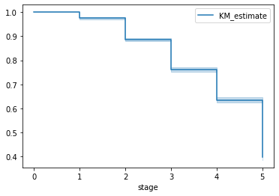
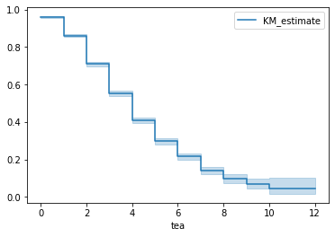
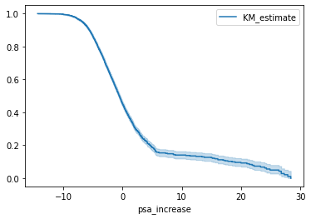
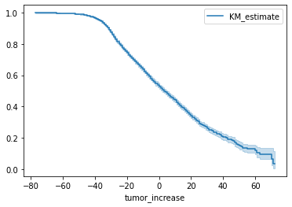
Kaplan-Meier Curve

